Slide 1


DISTRACTED DRIVER DETECTION
Using Deep Learning to Enhance Road Safety

Slide 2
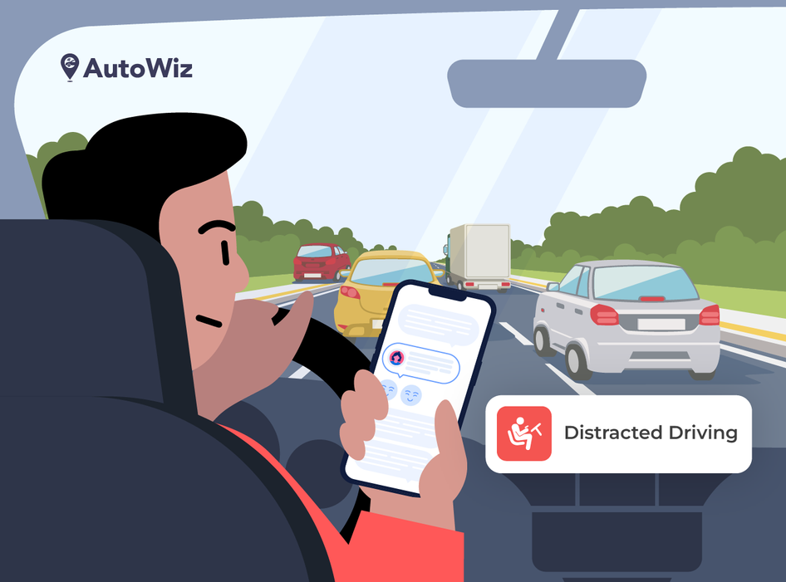
INTRODUCTION
What is Distracted Driving?
Distracted driving involves engaging in non-driving activities such as texting, eating, or using a phone, which diverts attention from the road.
Why is it a Problem?
A leading cause of road accidents globally.
Detecting distractions early can significantly reduce accident rates and save lives.
Objective of the Project:
Leverage deep learning to automatically detect and classify distracted driving behaviors from driver images.

Slide 3
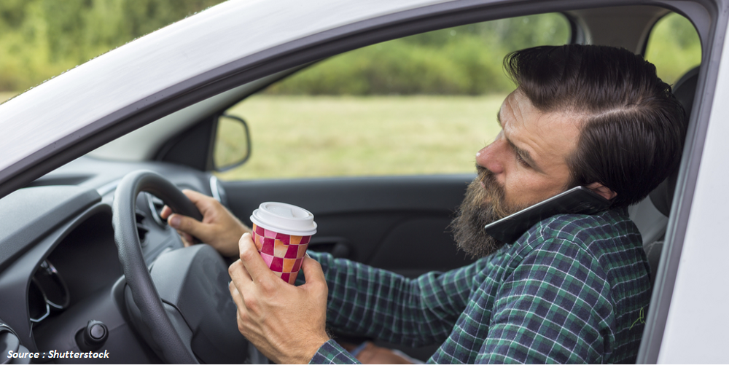
PROBLEM STATEMENT
Distracted driving is responsible for a large proportion of road accidents globally.
Common distractions include texting, eating, talking on the phone, and adjusting in-car systems.
Why It’s Critical:
Manual monitoring is impractical and inefficient.
Current road safety mechanisms lack real-time automated systems to detect distracted drivers.

Slide 4
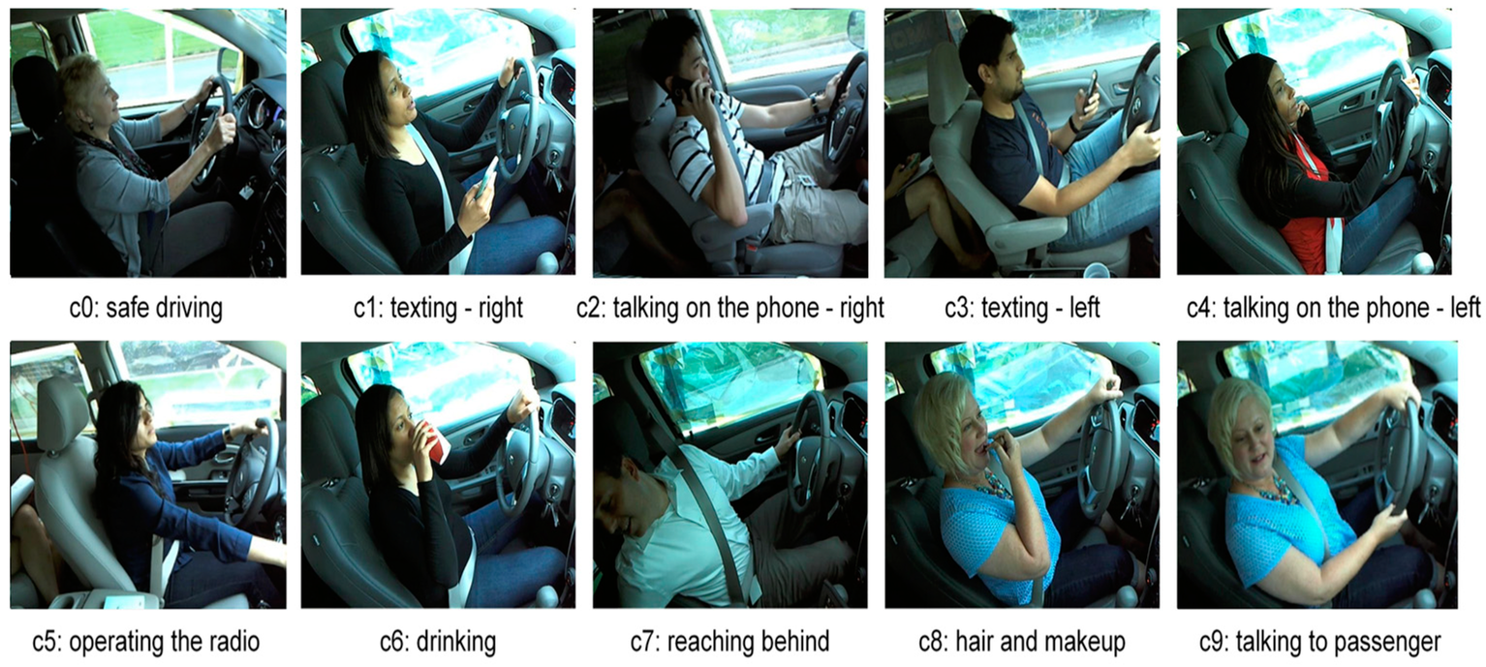
PROJECT OVERVIEW
Develop an automated system that uses deep learning to detect and classify distracted driving behaviors from driver images.
Dataset:
Source: Kaggle's State Farm Distracted Driver Detection dataset.
Size: 22,424 training images, 10 categories of driver behavior.

Slide 5
PROPOSED SOLUTIONS
System Overview:
Deep learning-based real-time driver monitoring system.
Key Steps:
Data Preparation:
Resize, normalize, and augment Kaggle dataset.
Deep Learning Model:
Fine-tune ResNet-18 for 10 distraction categories.
Training & Evaluation:
Train using transfer learning, Adam optimizer, and CrossEntropy loss.
Evaluate on training and validation subsets.

Slide 6
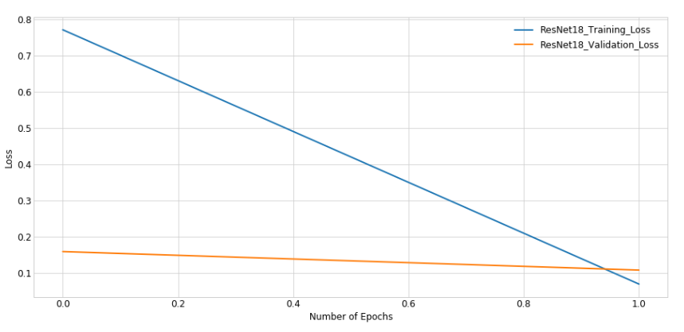
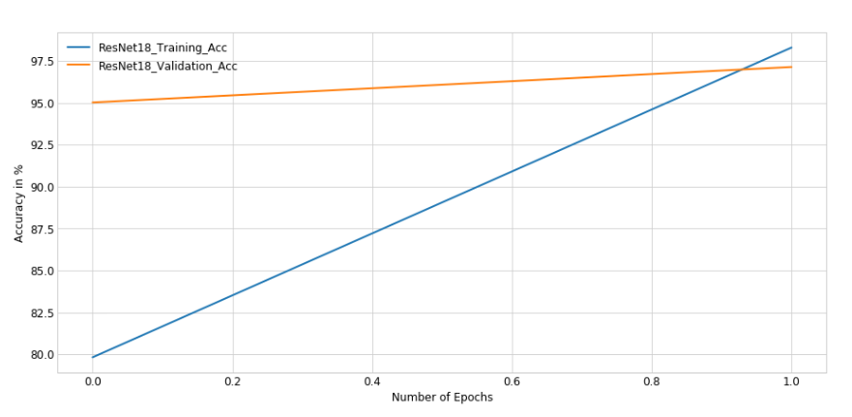
MODEL PERFORMANCE AND RESULTS
Performance Metrics:
Training Accuracy: 98.30%
Validation Accuracy: 97.14% (after 2 epochs).
Consistent improvement in loss across epochs.

Slide 7
Conclusion & Future Work
Conclusion:
Achieved high accuracy (98.30% training, 97.14% validation) for distracted driver detection.
The system can be used for real-time safety monitoring in vehicles.
Future Work:
Improving model performance:
Experiment with more advanced models (e.g., EfficientNet, ResNet50).
Real-time implementation:
Deploy the model on edge devices for in-vehicle monitoring.

Slide 8
THANK YOU!
Dhruv Goel

